Slide 1
640_dashboard sales
File created on: 11-08-2023 11:28:25

Slide 2
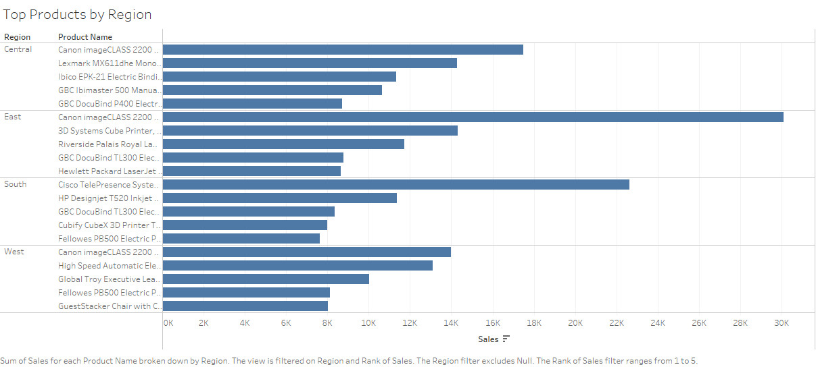

Slide 3
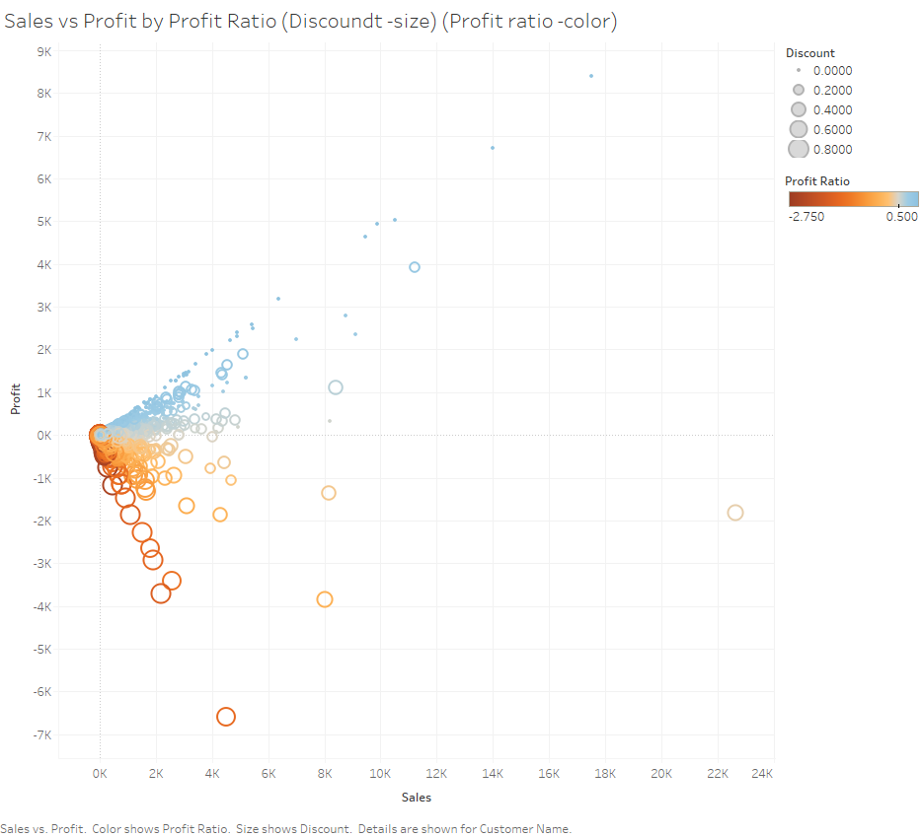

Slide 4
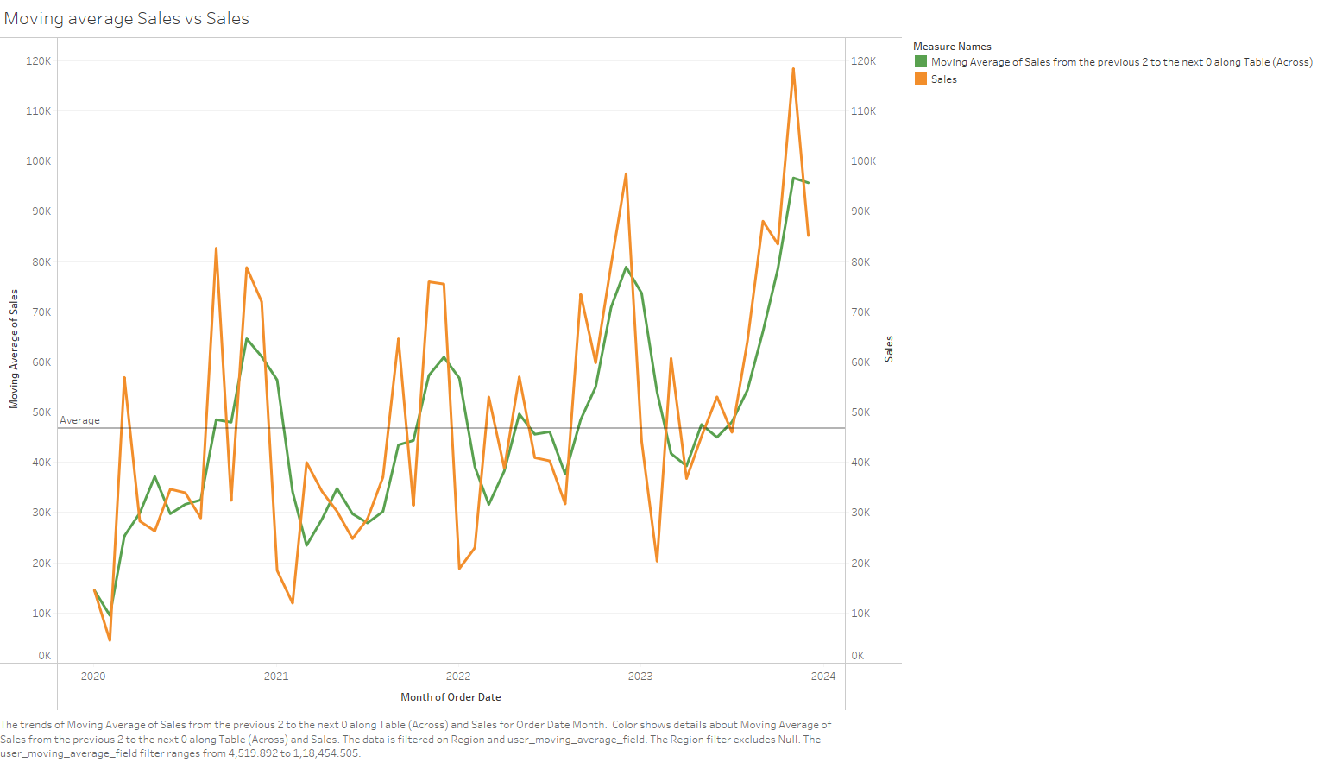

Slide 5
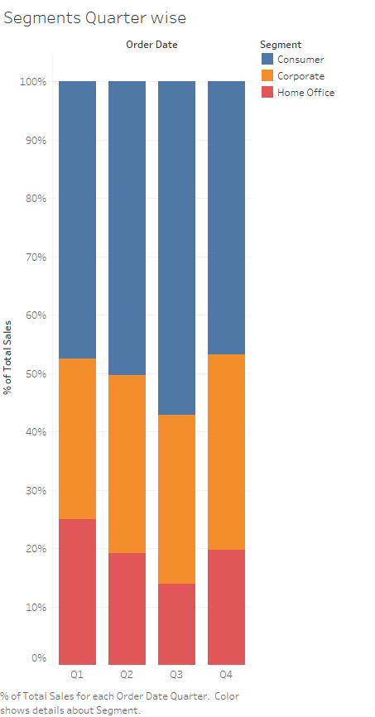

Slide 6
